Slide 1

CSC415 Operating System Principles
Main Memory
Professor Hao Yue
Fall 2017

Slide 2

Outline
Background
Contiguous Memory Allocation
Segmentation
Paging
Page Table

Slide 3
Background
Main memory and CPU registers are the only general-purpose storage that the CPU can directly access
CPU registers can be accessed within one cycle of CPU clock
One memory access may take many cycles of CPU clock, which causes a stall, since CPU does not have the data to complete the current instruction
Add cache between CPU and main memory for fast access
When CPU needs some data, it firsts checks whether it is in the cache. If so, the data is fetched directly form the cache. Otherwise, data is moved from main memory and a copy is stored in the cache for future access

Slide 4
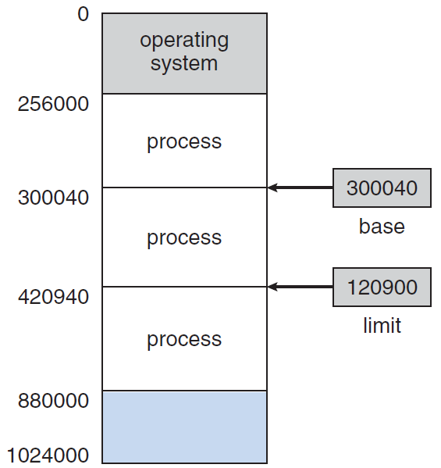
Background
Each process must have a separate memory space, which is fundamental for multiprogramming
Need to determine the range of legal addresses that one process can access
Protect OS from access by user processes
Protect the user processes from each other
One solution is using two registers
Base register holds the smallest legal physical memory address
Limit register specifies the size of the range

Slide 5
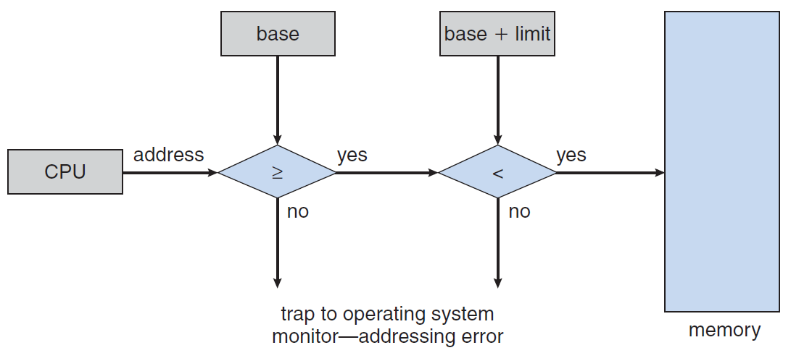
Background
CPU hardware compares every address generated in user mode with the registers
If the address is outside of the range determined by the two registers, it results in trap to OS
The base and limit registers can be loaded only by OS using a privileged instruction

Slide 6
Background
Logical address (virtual address): an address generated by the CPU
Logical address space: the set of all logical addresses generated by a program
Physical address: an address seen by the memory
Physical address space: the set of all physical addresses corresponding to the logical addresses
Memory-management unit (MMU)
Hardware device that maps virtual addresses to physical address when a program is running
There are different methods to accomplish such mapping

Slide 7
Background
Example:
Maintain a register called relocation register (similar to base register)
Add the value in relocation register to every address generated by a user process when the address is sent to memory
Logical addresses in the range 0 to max, and physical addresses in the range R+0 to R+max for a base value R

Slide 8
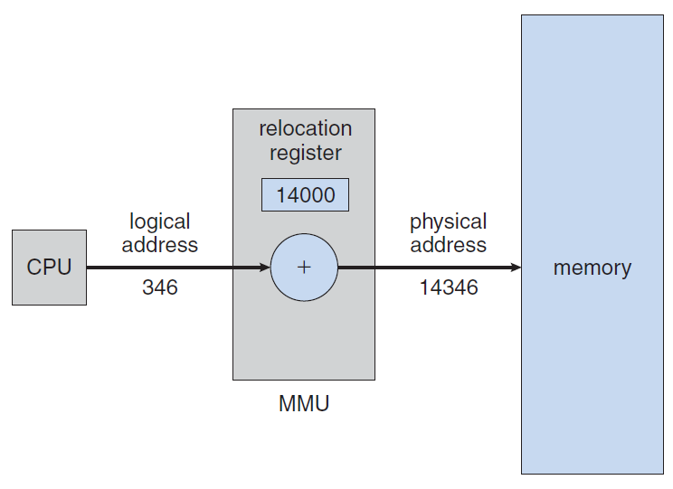
Background
Example:

Slide 9
Contiguous Allocation
There are various methods to allocate main memory to accommodate both OS and user processes
Contiguous allocation
Main memory is divided into two partitions
OS is usually in low memory
Each process is contained in a single section of memory that is contiguous to the section containing next process
Memory protection
Two registers: relocation register and limit register
Relocation register contains the value of the smallest physical address
Limit register contains the range of logical addresses
MMU maps the logical address by adding the value in the relocation

Slide 10
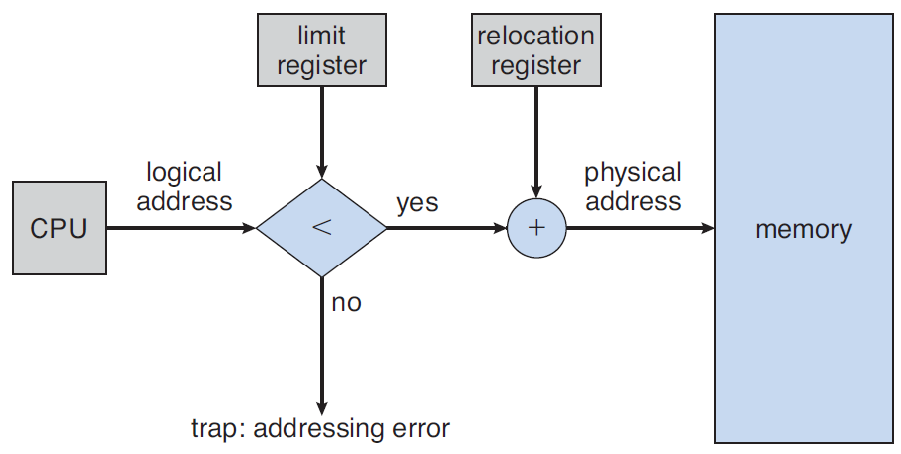
Contiguous Allocation
Memory protection
Two registers: relocation register and limit register
MMU maps the logical address by adding the value in the relocation register

Slide 11
Contiguous Allocation
Memory allocation
Fixed-sized partition
Memory is divided into several fixed-sized partitions and each partition contains exactly one process
When a partition is free, a process is selected and is loaded into the free partition
Variable-partition
OS maintains information on which parts of memory are available and which are occupied. A block of available memory is called a hole.
When a process arrives, it is allocated a hole that is large enough for it. The leftover part becomes a new hole.
When a process terminates, it releases the block of memory. If the block is adjacent to other holes, they are merged to form a new larger hole.

Slide 12
Fragmentation
Internal fragmentation
In fixed-sized partition, the memory allocated to a process may be larger than the requested memory. Unused memory is internal to a partition.
External fragmentation
As processes are loaded and removed from memory, the free memory space is broken into little pieces
External fragmentation exists when there is enough total memory space to satisfy a process but the available spaces are not contiguous.
Solutions to external fragmentation
Compaction: shuffle memory contents to place all free memory together in one large block
Allow the physical address space of the processes to be noncontiguous

Slide 13
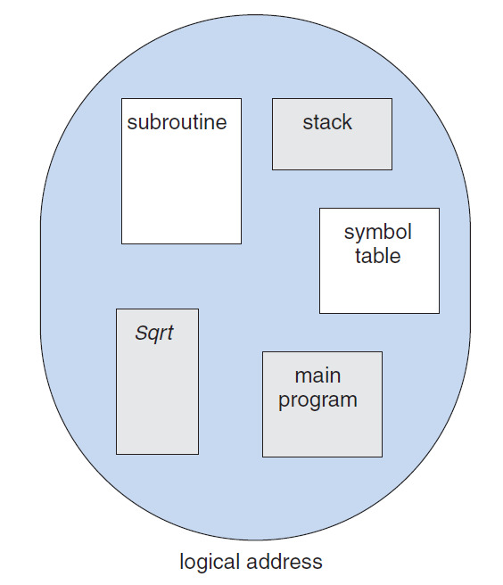
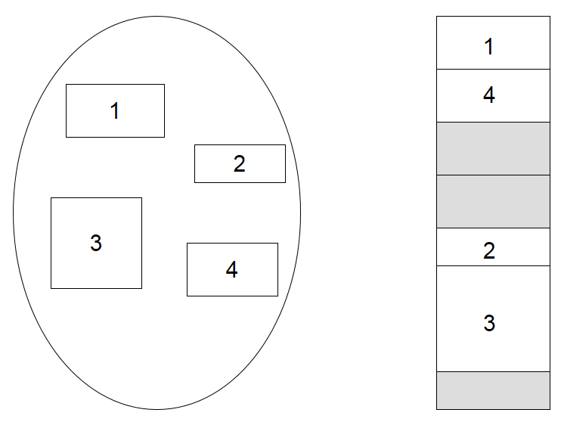
Segmentation
Idea: a logical address space is a collection of segments. Each segment has a name and a length
A logical address consists of two tuple: <segment-number, offset>

Slide 14
Segmentation
Divide the logical address space into a collection of segments
Segments can be stored in non-contiguous locations in main memory
Map logical addresses into physical addresses
Use a segment table, where each segment has a segment base and a segment limit
A logical address consists of a segment number s and an offset d
Use the segment number as index to the segment table to find the segment base value. Then, add the offset to the base value obtain the physical address.

Slide 15
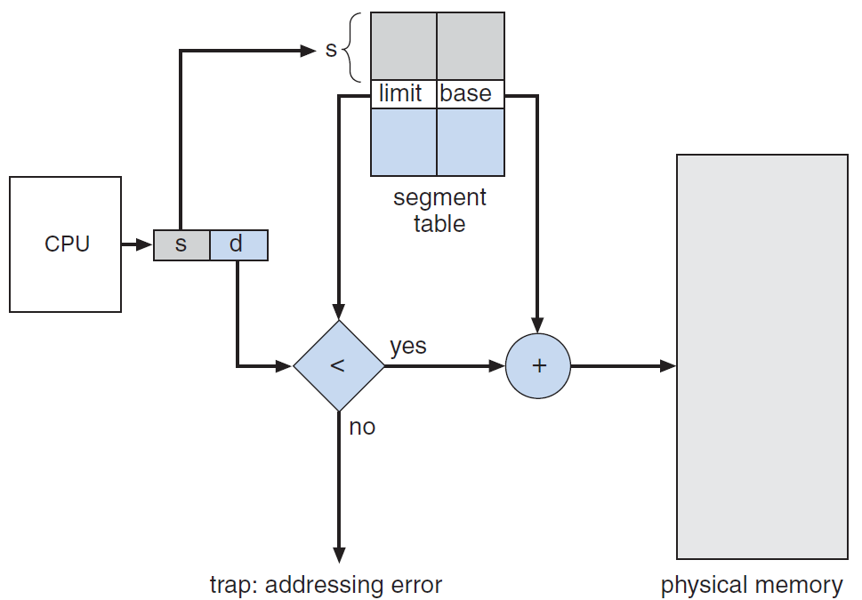
Segmentation
Example
Segment 2 is 400 bytes long and begins at location 4300
Logical address <2, 53> is mapped to physical address 4300+53=4353

Slide 16
Paging
Break physical memory into fixed-sized blocks called frames and break logical memory into blocks of the same size called pages
When a process is to be executed, its pages are loaded into the same number of memory frames
Page table contains the frame index for each page
A logical address is divided into a page number p and a page offset d
Page number is used as an index into a page table
Page offset combined with base address of each page to determine physical address

Slide 17
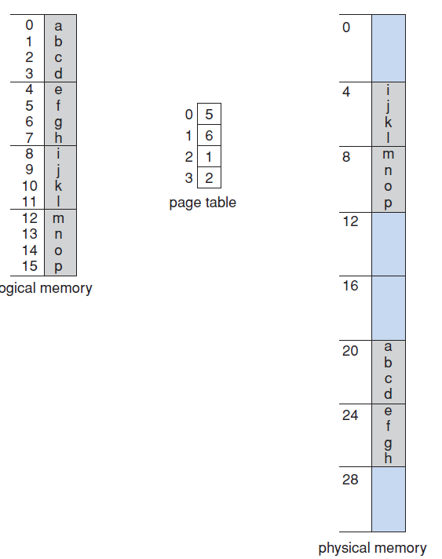
Paging
Example
Q: Logical address = <0, 0>
Physical address = ?
Q: Logical address = <2, 2>
Physical address = ?

Slide 18
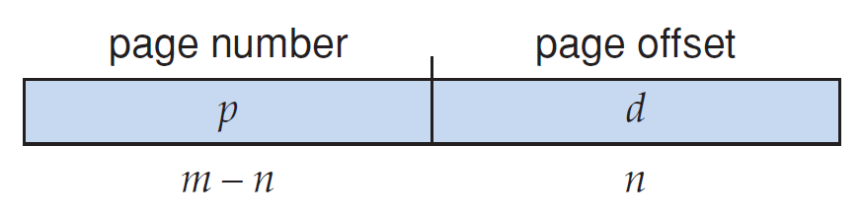
Paging
The size of a page is defined by the hardware, which is a power of 2
If a page size is 2^{n} and the size of the logical address space is 2^{m}, then the first m-n bits of a logical address designate the page number and the n low-order bits designate the page offset

Slide 19
Paging
Example
Q: m=? n=?
Q: Logical address = 0000,
Physical address = ?
Q: Logical address = 1010,
Physical address = ?

Slide 20
Paging
Paging has no external fragmentation
Any free frame can be allocated to a process that needs it
Paging has internal fragmentation
Frames are allocated as units
The last frame allocated to a process may not be full
Example
page size = 1,000 bytes, process size = 5,500 bytes
6 pages are allocated to the process
Internal fragmentation = 500 bytes

Slide 21
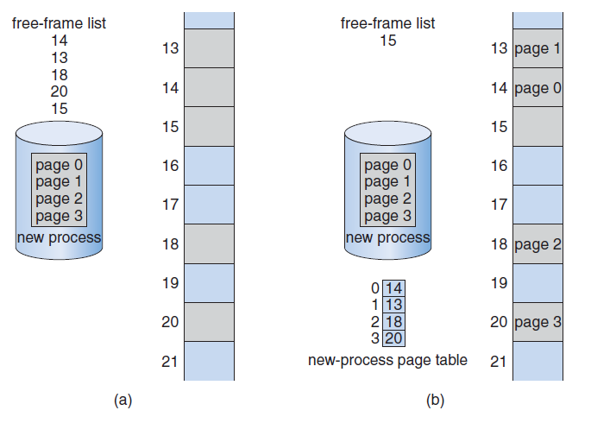
Paging
Memory allocation

Slide 22
Page Table
OS maintains a copy of the page table for each process. A pointer to the page table is stored in the PCB
Page table is usually kept in main memory
Disadvantage: two memory accesses are needed to access data/instruction in main memory
One for accessing page table to find the frame base address, one for accessing data/instruction in main memory
Better idea: use a special, fast-lookup hardware cache called translation look-aside buffer (TLB)

Slide 23
Page Table Structure
Standard page table in modern computer systems can be huge
Example
Consider a computer system with 32-bit logical address space and 4KB page size (2¹²)
The number of entries in the page table = 2³²/2¹²
The page table needs 4MB of physical space if each entry consists of 4 bytes
Divide the page table into smaller pieces and store them in main memory

Slide 24
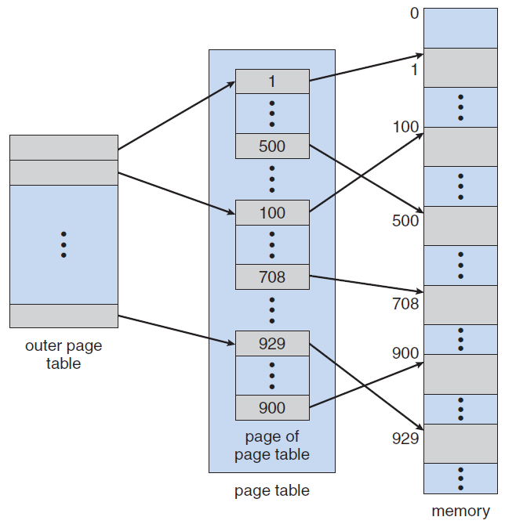
Hierarchical Paging
Two-level paging algorithm, where the page table itself is also paged

